Slide 1
Reactive microservice end to end from RxJava to the wire with gRPC
Ryan Michela @ Salesforce
Notes:
project i've been working on - reactive grpc

Slide 2
Let’s poll the room
gRPC
Notes:
Istio day earlier in week

Slide 3
Let’s poll the room
RxJava

Slide 4
Let’s poll the room
gRPC
RxJava

Slide 5
About me
ME
gRPC
RxJava
Microservices practitioner
Reactive programming enthusiast
Notes:
A bit about myself
- Salesforce service mesh

Slide 6
What’s in this talk
The story of reactive-grpc
An overview of gRPC and RxJava
Some great demos
A deep dive into backpressure and flow control
An even better demo

Slide 7
Where did Reactive-gRPC come from?
20 year old monolith to Microservices
Bespoke REST APIs
Apache Thrift
gRPC + Mesh

Slide 8
What is gRPC?
High-performance, open source, RPC framework
Protobuf and HTTP/2
Big features
Contract-first microservices
Polyglot code generation
Unary and bi-directional streaming
https://grpc.io/
Notes:
Built in the public
RPC vs Rest

Slide 9
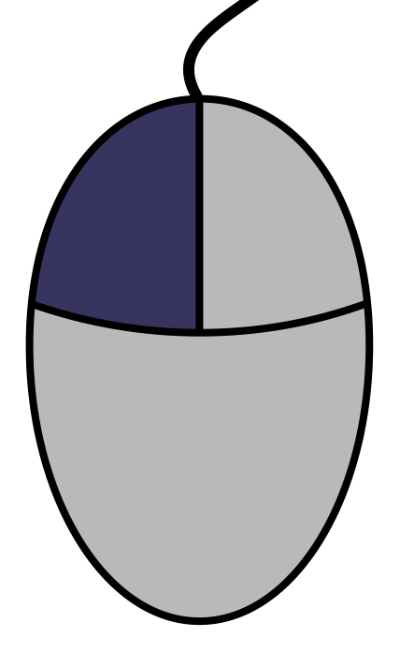
What is RxJava?
API for asynchronous programming with observable streams
Everything is a stream (Observable)
Combine, filter, transform
Subscribe (Observer)
http://reactivex.io/
Notes:
RxJava treats everything as a stream

Slide 10
What is RxJava?
API for asynchronous programming with observable streams
Everything is a stream (Observable)
Combine, filter, transform
Subscribe (Observer)
JavaFxObservable.eventsOf(scene, MouseEvent.CLICK)
.debounde(1, TimeUnit.SECONDS)
.map(event -> new RobotCommand(event))
.subscribe(command -> robot.do(command));

Slide 11
1+1=3
https://imgur.com/gallery/c7NJRa2

Slide 12
Reactive gRPC
gRPC
RxJava
Protobuf compiler plugin + new stubs

Slide 13
Questions so far?

Slide 14
Hello World demo - What will we see?
Only gRPC
Reactive gRPC
Protobuf IDL
Protoc code generator
Single<T> and Flowable<T>
Notes:
Simple gRPC service
Reactive-gRPC throw in

Slide 15
Demo summary
Hello.proto defines operations and data structures
Protoc compiler generates java stubs from proto during build
Client and server build on generated stubs
Reactive-gRPC generates RxJava stubs, extends protoc compiler
RxJava makes writing streaming services easy

Slide 16
Questions so far?

Slide 17
Backpressure
How downstream consumers signal to producers to slow down
https://cheezburger.com/7944963840
Notes:
Classic episode of I love Lucy?

Slide 18
Three Backpressure Strategies
Reactive gRPC

Slide 19
Producer?
Consumer?

Slide 20
HTTP/2 backpressure and flow control
Stream-based flow control – per stream and per connection
Initial flow control window size 65,535 bytes
Producer stops when window closes
Consumer asks for more bytes by sending a WINDOW_UPDATE frame
Flow Control Window
Producer
BYTES
Flow Control Window
Consumer
WINDOW_UPDATE

Slide 21
gRPC backpressure and flow control
Message-based flow control over HTTP/2
Producer
OnReadyHandler produces and serializes proto messages until HTTP/2 flow control window is exhausted or there are no more messages to send
WINDOW_UPDATE frames from consumer re-trigger OnReadyHandler
Producer
OnReady Handler
onNext(message)
Ready?
HTTP/2
Flow Control Window
BYTES
Flow Control Window
WINDOW_UPDATE

Slide 22
gRPC backpressure and flow control
Message-based flow control over HTTP/2
Consumer
Consumer calls request()
gRPC deserializes messages and calls onNext()
gRPC sends WINDOW_UPDATE frames to receive more bytes
Producer
OnReady Handler
onNext(message)
Consumer
onNext(message)
Ready?
HTTP/2
Flow Control Window
BYTES
Flow Control Window
WINDOW_UPDATE
request()

Slide 23
RxJava backpressure and flow control
Message-based flow control over Java method invocations
Consumer calls request()
Producer calls onNext()
Intermediate operators propagate both calls
Producer
Observable
Operator
Map
Operator
Reduce
Consumer
Observer
request()
request()
request()
onNext()
onNext()
onNext()

Slide 24
Reactive-gRPC backpressure and flow control
Message-based flow control over RxJava over gRPC over HTTP/2
RxJava
Observable
Observer
onNext()
request()
Operator
Operator
request()
onNext()
gRPC
OnReady Handler
onNext()
Consumer
onNext()
Ready?
HTTP/2
Flow Control Window
Flow Control Window
request()

Slide 25
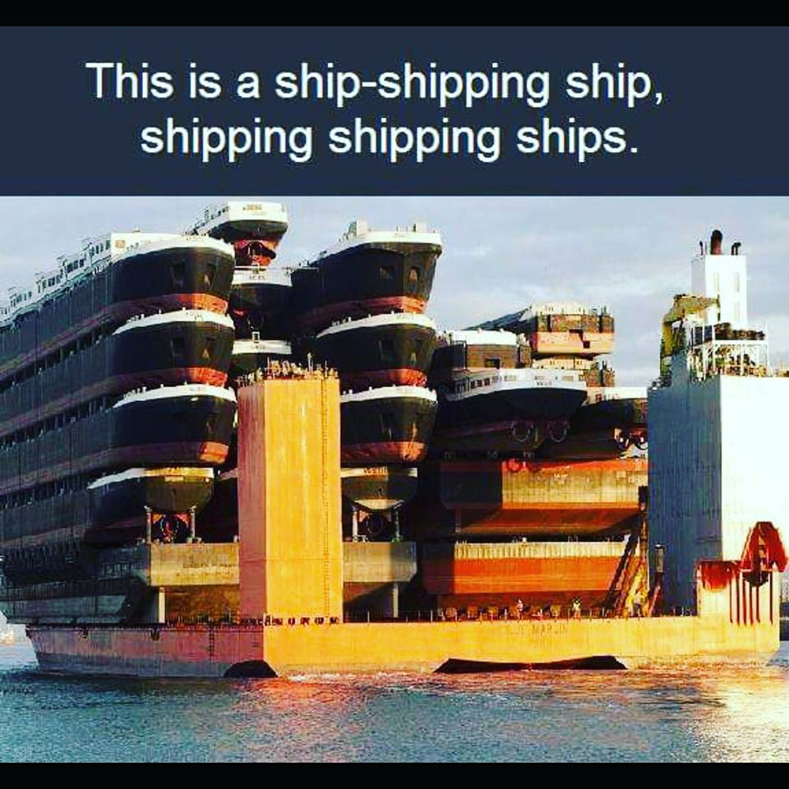
Reactive-gRPC backpressure and flow control
Message-based flow control over RxJava over gRPC over HTTP/2
RxJava
Observable
Observer
onNext()
onNext()
request()
request()
Operator
Operator
onNext()
onNext()
request()
request()
gRPC
OnReady Handler
onNext()
Consumer
onNext()
Ready?
HTTP/2
Flow Control Window
Flow Control Window
request()
https://imgur.com/gallery/kW0tzFN

Slide 26
Questions so far?

Slide 27
Backpressure demo – What will we see?
Slow consumer
Fast producer

Slide 28
Demo summary
Fast producer
Slow consumer
Producer outpaces consumer
Producer slows down
Backpressure is free (for you)

Slide 29
Questions so far?

Slide 30
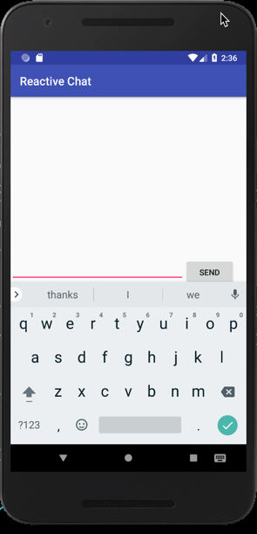
Applied Reactive-gRPC demo – What will we see?
IRC-like Chat
Command line
JavaFX Desktop
Android Mobile

Slide 31
Applied Reactive-gRPC demo – What will we see?
ChatMessage ➜ Empty
Empty ➜ stream ChatMessage
Server

Slide 32
Demo summary
Reactive-gRPC make chat server trivial to write
Three different clients, nearly identical code
Command line
JavaFX
Android

Slide 33
To Conclude
gRPC makes microservices easy
.proto IDL
Code generation
RxJava is a different way of thinking
Streams of events
Function composition
Reactive-gRPC bridges both technologies

Slide 34
Why Reactive-gRPC?
Async by default
Notes:
First:
Reactive programming built from the ground up for async processing

Slide 35
Why Reactive-gRPC?
Unified programming model
Notes:
Second:
Sync and Async work the same

Slide 36
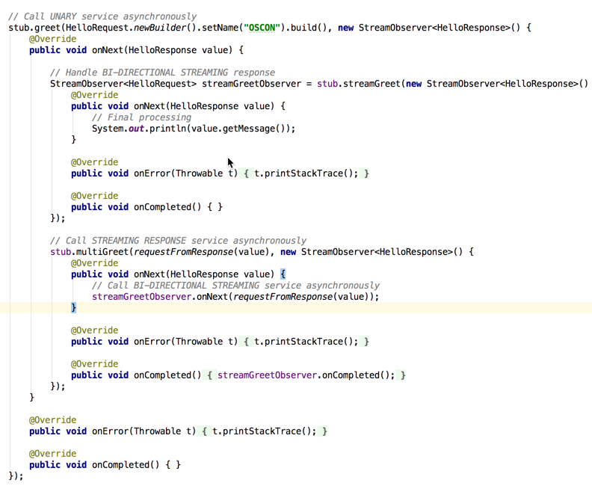
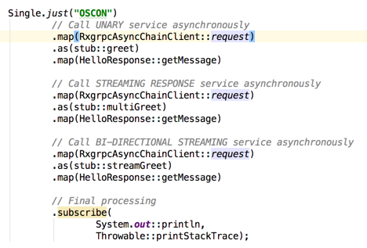
Why Reactive-gRPC?
Simplified programming model
Notes:
Third:
Less callback hell
More code clarity

Slide 37
Why Reactive-gRPC?
Consistent programming model
Notes:
Finally:
Serivces
Desktop
Mobile

Slide 38
Thank you!
Resources
https://grpc.io/
http://reactivex.io/
https://github.com/salesforce/reactive-grpc
👆Demo code
Questions?
Notes:
Now open up to questions

